Slide 1

UNIT
DAY 22
02
CONDITIONALS
BUILT TO ORDER
AGENDA
REMINDERS
Phones into The Holding Cell
Open/Closed Laptop
Lab open/accessible
Warm Up
True or False?
if / else
elif
The Order Kiosk
Close
Vocabulary
RECOMMENDED LISTENING:
OBJECTION! – ACE ATTORNEY

Slide 2

THE WARM UP QUESTION
Read this program. The user types 14 and presses Enter.
What appears on the screen?
age = input("How old are you? ")
print(age == 14)
→ Lab Warm Up: write your prediction before you run anything.

Slide 3
THE WARM UP ANSWER
It prints False.
A comparison is always answered by either True of False
input() gave back the string "14", and a string doesn’t equal the number 14.
→ Lab Warm Up: fill in the second box (what appeared, and why).
age = int(input("How old are you? "))
print(age == 14) # True

Slide 4
TRUE OR FALSE?
A condition is an expression that evaluates to True or False
True and False are their own type: a Boolean (bool).
No quotes: True is a Boolean, "True" is just a string of text
print(10 > 3) # True
print(10 < 3) # False
print(type(10 > 3)) # <class 'bool'>

Slide 5
COMPARISON OPERATORS
== equal to
!= not equal to
< > less than, greater than
<= >= less than or equal to, greater than or equal to
One = stores a value. Two == asks a question (now THIS is equality like in math class!)
→ Now: Lab questions 1–2

Slide 6
IF / ELSE
if runs its block only when the condition is True.
else has no condition, because it runs only when the if was False.
The colon and the indentation show which lines belong to which branch.
age = int(input("How old are you? "))
if age >= 13:
print("You can join the club.")
else:
print("Come back when you are 13.")
Notes:
Live-code this and run it twice, once for each branch. Point at the four spaces: they are not decoration, they are how Python knows which lines are inside the if.

Slide 7
WHEN IFS GO WRONG
if age = 13: → SyntaxError. Comparing needs ==.
if age >= 13 → SyntaxError. The colon is missing.
A line under if that is not indented → IndentationError.
if age >= "13": → TypeError. Compare numbers with numbers.
→ Lab question 4 has three of these bugs hidden in it.
→ Now: Lab questions 3–4
Notes:
Break the slide 6 program live, one bug at a time, and read the last line of each error aloud. Students should learn to recognise these messages on sight.

Slide 8
ELIF
elif means "else, if". Use it when there are more than two choices.
Python checks from the top down and runs the first block that is True, skipping the rest of that chain
score = int(input("Score out of 100? "))
if score >= 90:
print("A")
elif score >= 80:
print("B")
else:
print("Keep practising")
Notes:
Trace it with 95, 85 and 40. Then ask: with 95, why does it not also print B, when 95 >= 80 is True as well? Because the chain stops at the first True branch.

Slide 9
PREDICT THE OUTPUT
The user types 30. What prints?
→ Bonus: what change would make it print "Hot"?
→ Now: Lab questions 5–6 (question 6 is this exact bug)
temp = int(input("Temperature in Celsius? "))
if temp > 10:
print("Mild")
elif temp > 25:
print("Hot")
else:
print("Cold")
Notes:
Answer: Mild. 30 > 10 is True, so the first branch runs and the chain stops before it ever checks temp > 25. The fix is to put the most specific condition first: check > 25 before > 10.

Slide 10
THE ORDER KIOSK
Build the self-order kiosk for a food truck, café or shop of your choice.
Ask at least three questions, and use casting on at least one answer
Set a price with an if / elif / else chain of at least three branches
Use else to handle a choice that is not on the menu
Make a second decision, such as a discount
Calculate the total and print a receipt with a border
→ Lab questions 7–8 (the checklist is in Section 4)
Notes:
This is Lab Section 4 and the main task. Read the checklist together, then show the sample run on the next slide. Students should test with inputs that reach every branch, including a choice that is not on the menu.

Slide 11
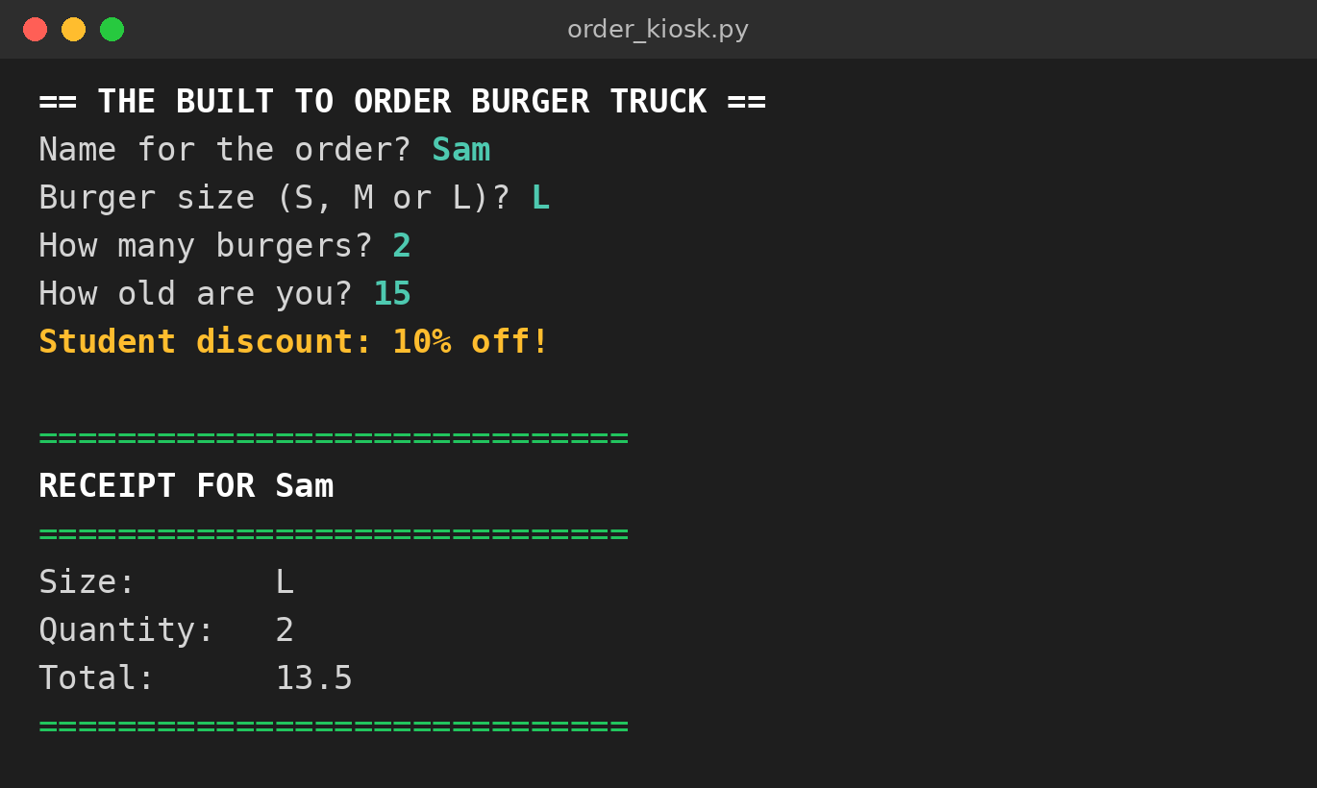
WHAT IT LOOKS LIKE
Green answers are what the customer typed.
The size picks the price through if / elif / else.
A second if gave the under-18 discount.
→ What would it print for size X?
→ Now: Lab question 7
Notes:
Callout answer: in the sample solution, an unknown size falls through to else, which prints a message and charges for a medium instead. Push students to choose deliberately what their own else does.

Slide 12
CLOSE
→ Exit question: the user types 18. What prints, and why?
if age > 18:
print("Adult")
else:
print("Under 18")
Save your lab as Surname_Lab2-5 and upload it to ManageBac.
→ Lab question 8: answer the reflection before you upload.
Notes:
Exit answer: "Under 18", which is wrong for an 18-year-old. 18 > 18 is False. The fix is >=. This is the classic off-by-one boundary bug, and it shows why testing the exact boundary value matters.

Slide 13

VOCAB TO REMEMBER
Condition - an expression that evaluates to True or False
Boolean (bool) - the type of True and False
Comparison operator - ==, !=, <, >, <= or >=
if - runs a block only when its condition is True
elif - "else, if": checked only when the ones above were False
else - runs when no condition above was True
Indentation - the spaces that show which lines belong to a branch
Branch - one of the possible paths through an if statement
Notes:
Quick-fire: read a definition, students call out the term.

Slide 14
FURTHER READING
Python docs: if statements
Python docs: Comparisons
W3Schools: Python If ... Else
W3Schools: Python Booleans
Real Python: Conditional Statements
Notes:
Share the links on ManageBac for anyone who wants more practice.

